Slide 1
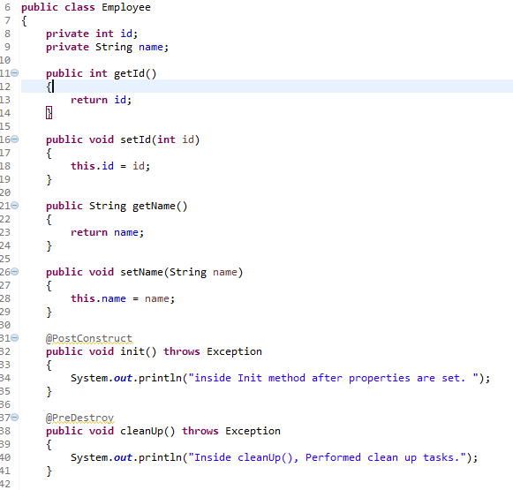
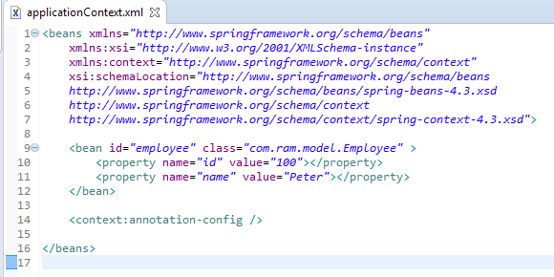
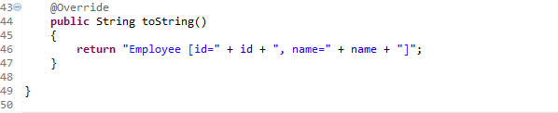
Spring @PostConstruct and @PreDestroy
In Spring, we can either implements InitializingBean and DisposableBean interface or specify the init-method and destroy-method in bean configuration file for the initialization and destruction callback function or we can use annotation @PostConstruct and @PreDestroy to do the same thing.
The @PostConstruct and @PreDestroy annotation are not belong to Spring, it’s located in the J2ee library – common-annotations.jar.
By default, Spring will not aware of the @PostConstruct and @PreDestroy annotation. To enable it, we have to either register ‘CommonAnnotationBeanPostProcessor‘ or specify the ‘<context:annotation-config />‘ in bean configuration file,

Slide 2
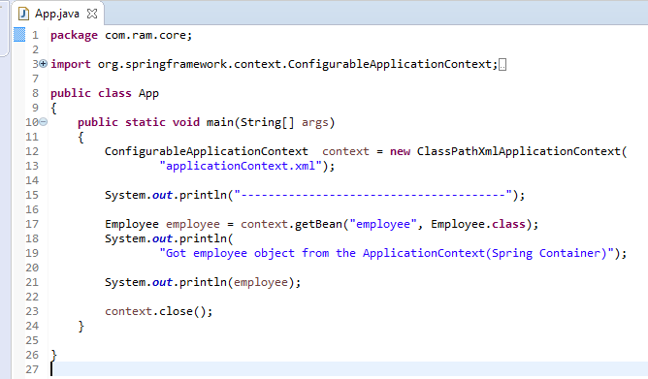
Spring @PostConstruct and @PreDestroy
The ConfigurableApplicationContext.close()will close the application context, releasing all resources and destroying all cached singleton beans.

Slide 3
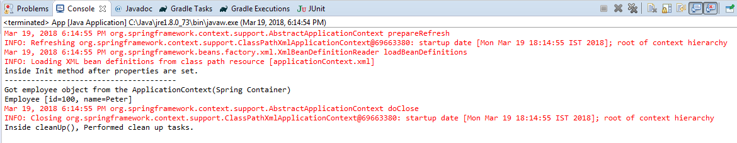
Spring @PostConstruct and @PreDestroy
The init() method (@PostConstruct) is called, after the message property is set.
The cleanUp() method (@PreDestroy) is call after the context.close();

